Slide 1
pFA Housing project
Submitted by:
Rohit Kattewar

Slide 2
Introduction
Houses are one among the required need of every and each person round the globe and thus housing and land market is one among the markets which is one among the main contributors within the world’s economy.
It’s a really large market and there are various companies working within the domain. Data science comes as a really important tool to unravel problems within the domain to assist the businesses increase their overall revenue, profits, improving their marketing strategies and that specialize in changing trends in house sales and purchases.

Slide 3
Problem Statement And Understanding
A US-based housing company named Surprise Housing has decided to enter the Australian market. The corporate uses data analytics to get houses at a price below their actual values and flip them at a better price. For an equivalent purpose, the corporate has collected a knowledge set from the sale of homes in Australia. The corporate is watching prospective properties to shop for houses to enter the market.
The company wants to know:
Which variables are important to predict the worth of variable?
How do these variables describe the worth of the house?
In the real world the problem can be used to detect the worth of homes with the available independent variables.

Slide 4
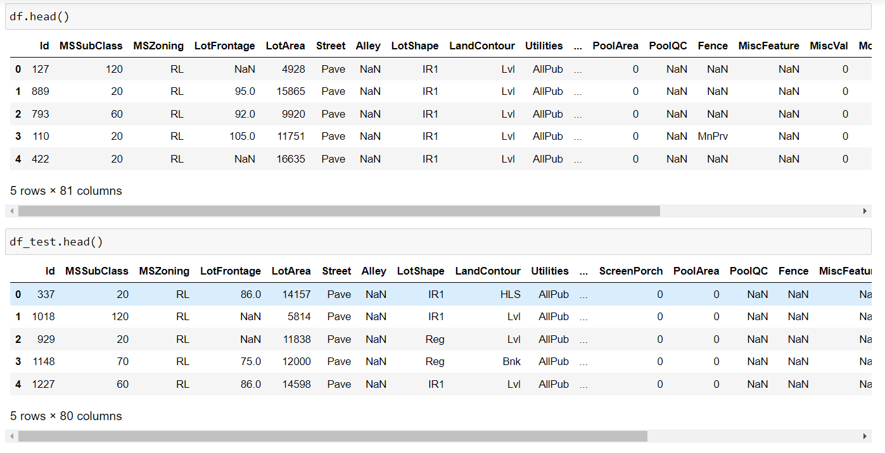
Dataset

Slide 5
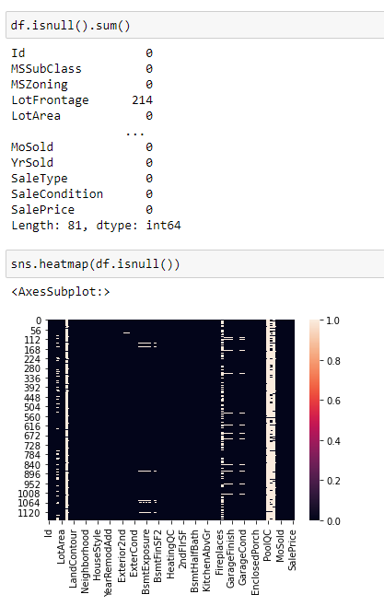
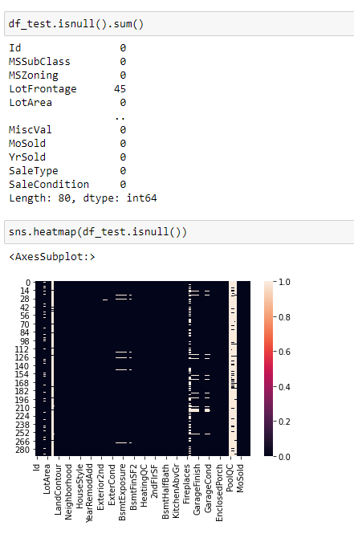
Data pre-processing

Slide 6
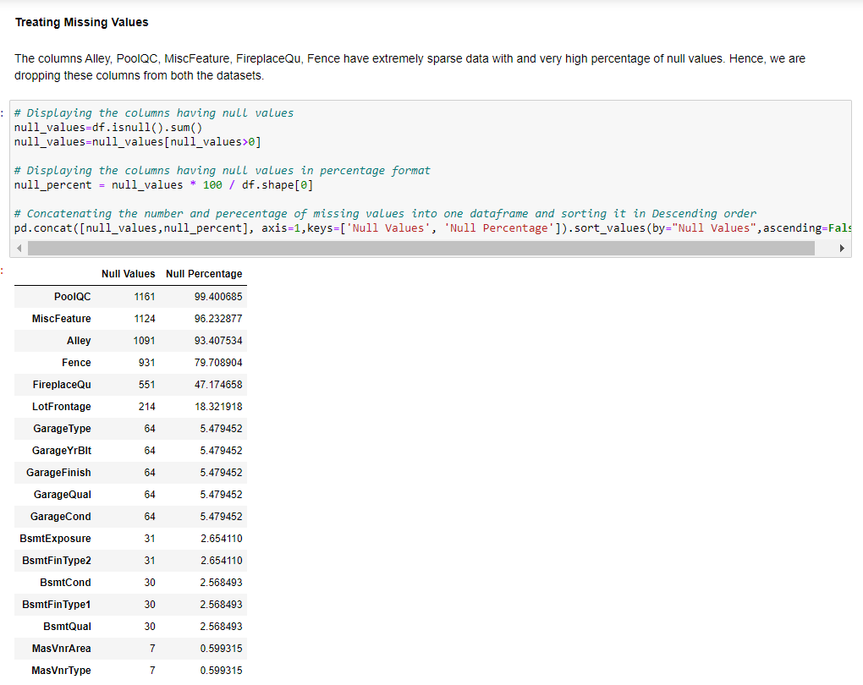
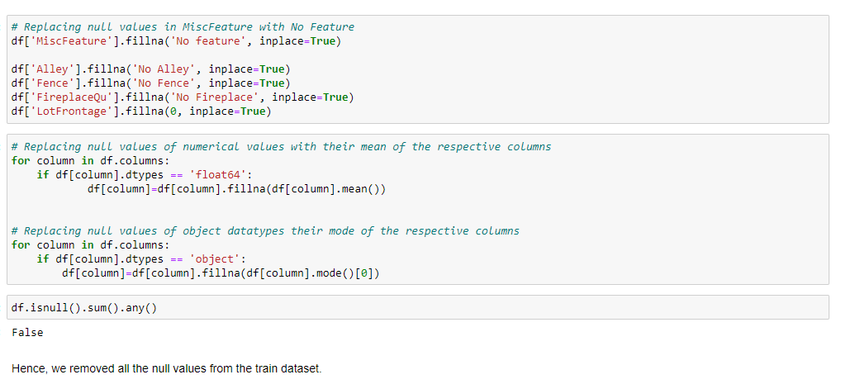
Data pre-processing

Slide 7
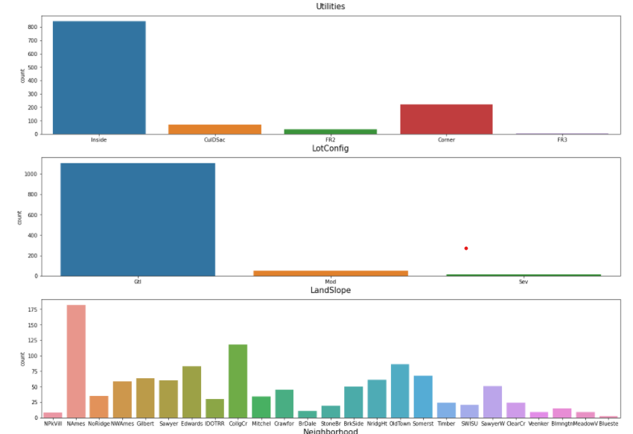
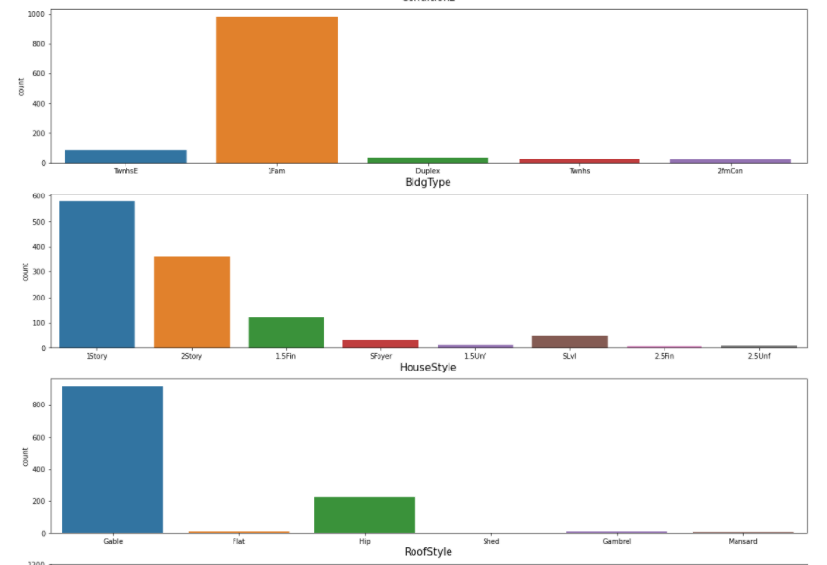
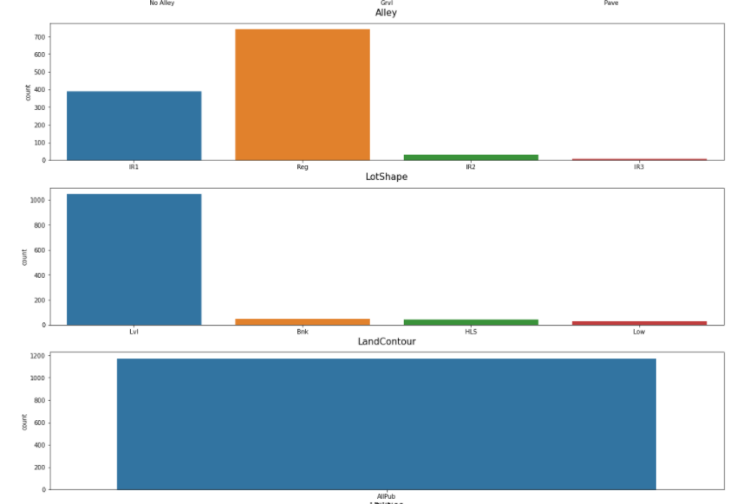
Visualizations

Slide 8
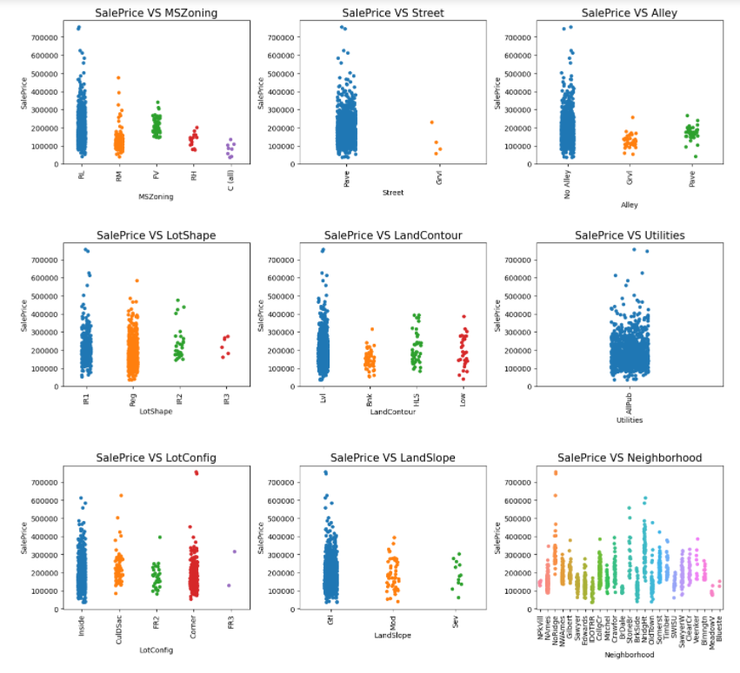
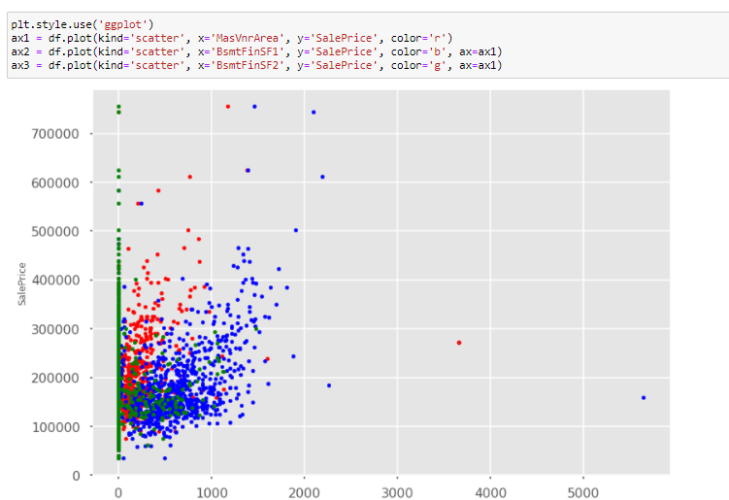
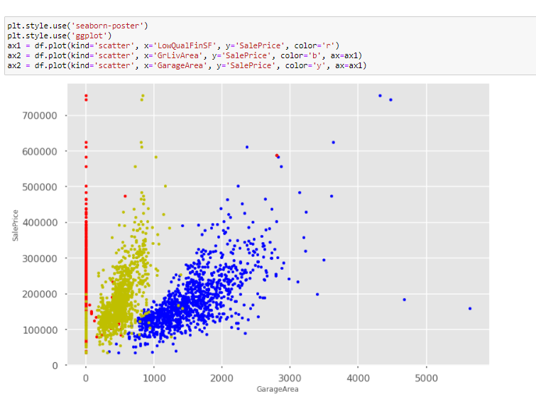
Visualizations

Slide 9
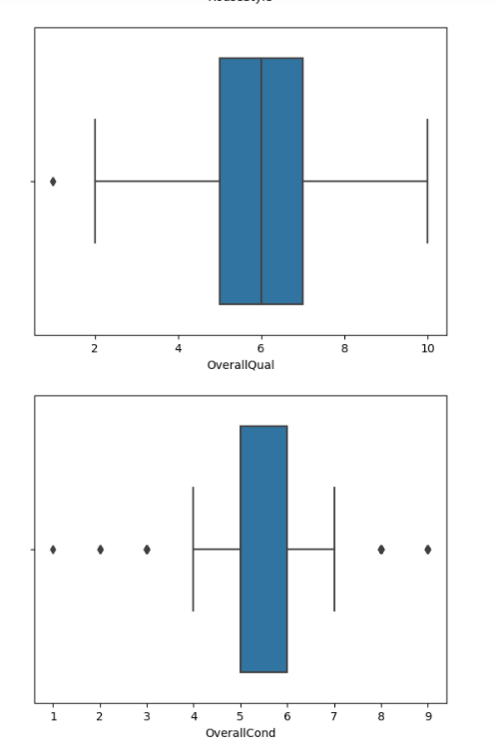
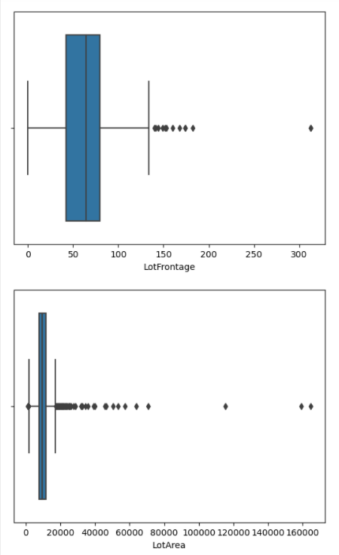
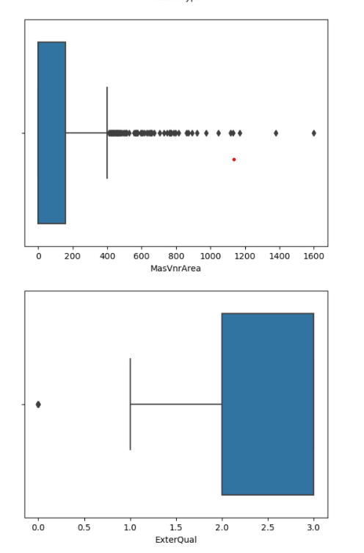
Visualizations

Slide 10
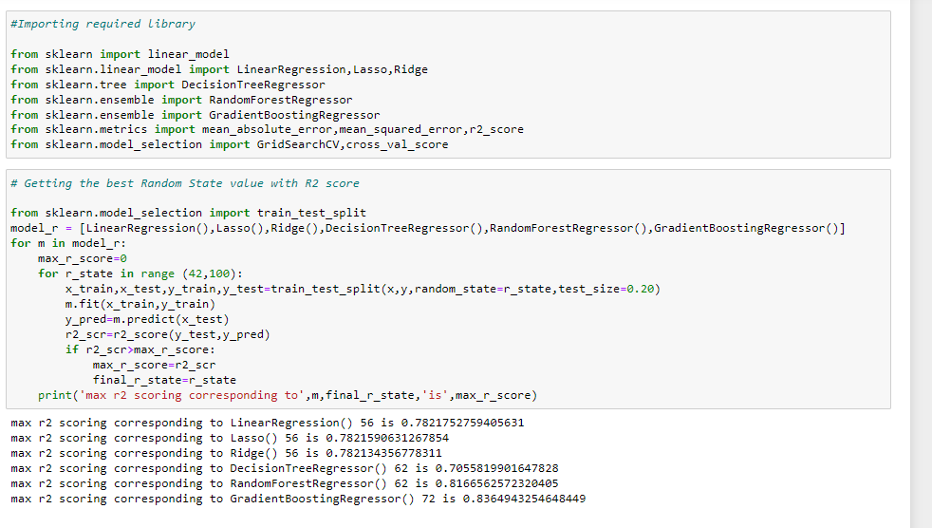
Model building
GradientBoostingRegressor has the best performance metrics with a good R2 score. So, we chose GradientBoostingRegressor as the finalized model.

Slide 11
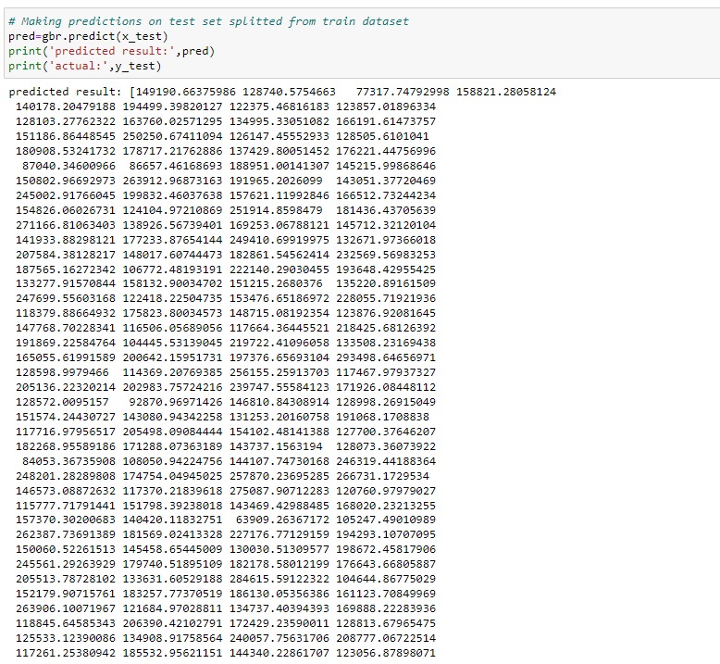
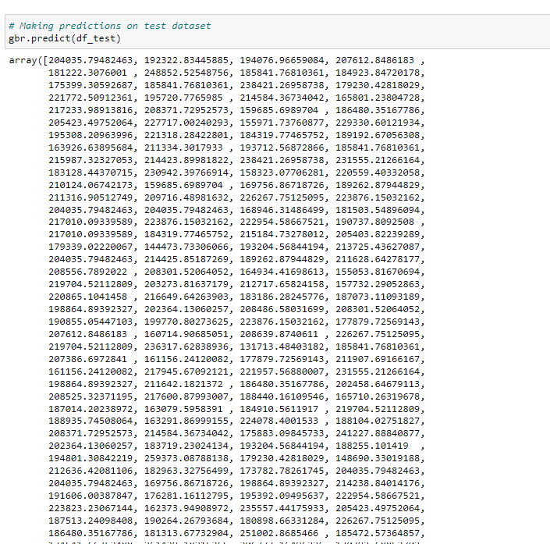
Predicted values

Slide 12
conclusion
The goal is to achieve the system which will reduce the human effort to find a house having reasonable price. The proposed system House Price Prediction model approximately tries to achieve the same one. We have managed out how to prepare a model that gives users for a best approach with future lodging value predictions. Proposed system focused on predict the house price according to the area and machine learning methods are used. The experimental results showed that this technique that is used while developing system will give best prediction of house price.

